Slide 1
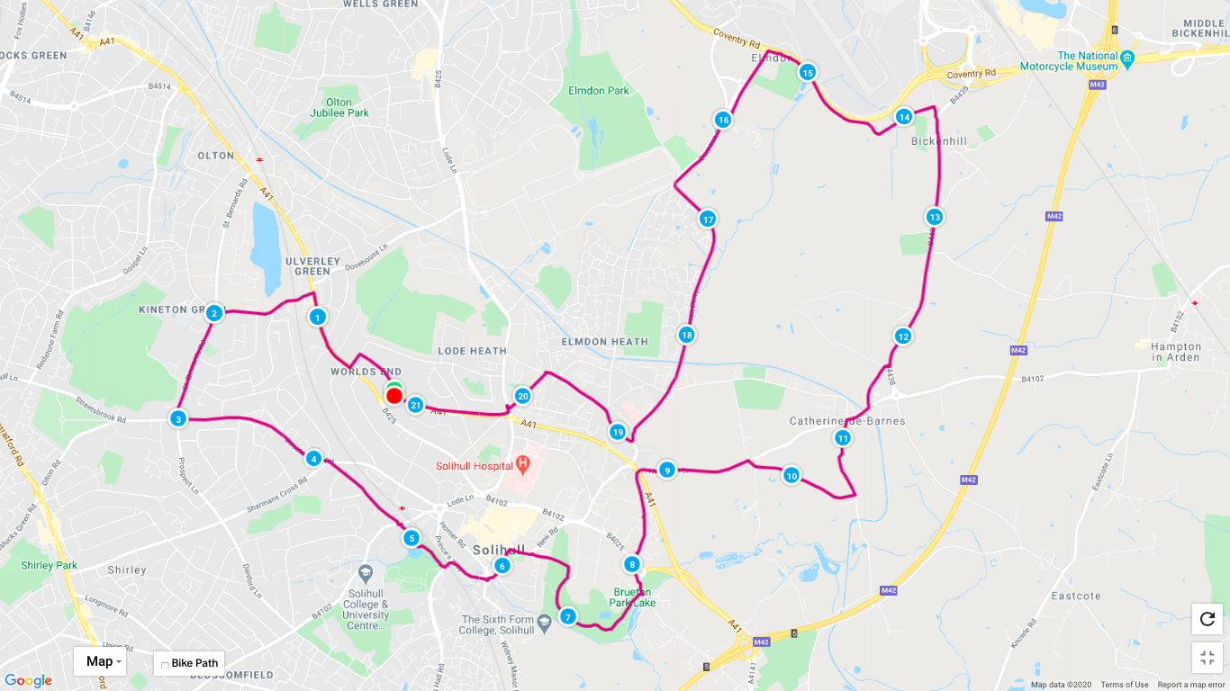
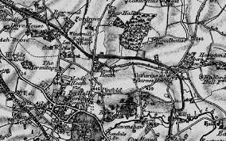
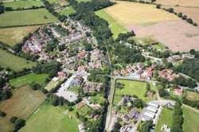
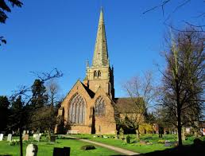
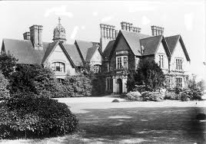
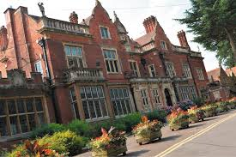
CLICK FOR THE MAPMYRUN MAP!
Look out above!
MOTR
MARSHAL
One of the oldest parts of town! Click to read more! Olton
Did you know there
was a hospital here?
St Helens Church! Our spiritual home!
v
CLICK!
HALF WAY REFRESHMENTS
Click here for more info on this historic grade II listed house!
MARSHAL
MUMS ON THE RUN - HALF MARATHON - SUN 9TH DEC 2020

Slide 2
MUMS ON THE RUN
2020 HALF MARATHON
13.1
The MotR Half Marathon will take place, even if it is raining and cold, on Sunday 20th December, starting at 9am from St Helens Church, St Helens Road, B91 2DA. Please use the church car park and DO NOT park on the road. Please do not bring valuables with you, unless you are happy to leave them in your car and potentially lose them! If you are unable to run with your car key on your person (in a pocket or running belt) our Marshal will be happy to collect them in but they will only be able to return them at the finish line.
The cost to enter is £5, which includes an amazing festive themed goodie bag and simply covers the costs of the awesome stuff inside! This can be paid via our club app or in person on the day, but you must register for the race in advance using this form!
There will be no St Johns Ambulance on course. There will be a basic first aid kit with the official race Marshal Stuart at 5km, 10.55km (half way), between KM 15 and 16 on Old Damson Lane and then at the finish! Stuart will also gladly take anyone in the car back to the finish line if the need arises, but you will have to wait as he completes his very important duties that will help make this run enjoyable and stress free!
There is no time limit, but if you need to be collected off the route at any point, either wait until you reach our Marshal and ask for a lift back or call your emergency contact to come and get you but you MUST inform coach Sarah by text or call immediately when you’ve made that decision. Sarah will have her phone for the duration for you to contact her in an emergency. The number is 07702 022914. STORE IT IN YOUR PHONE! If you are not running with your phone, we will identify the runners that are so that you can choose to stick with them along the course.
The route is challenging, with inclines, some 50mph roads with no paths and there might be mud, debris or standing water under foot. Do not take any risks! High visibility running clothing MUST be worn! Marshal Stuart will be able to collect in any unwanted layers like waterproofs, jackets, gloves etc as you pass him on course! Please remember to collect your items back in at the finish line!
This is not an official run. Its a fun run organised by Coach Sarah, therefore, there will be no road closures, no toilets along the route or anything fancy we are used to at the usual organised run events! Sarah has taught you all how to squat, so if you are caught short, find a suitable bush to hide behind, do what you need to do and rejoin the course asap!
The course will be checked by being driven around the day before the run. Sarah will advise on the morning of the run of anything to be aware of, but be aware this could have changed from the time she drove the route, to the time we run the route. The route will be planned as accurately as possible to 13.1 miles/21.1km and a stop watch will time the event but if you are looking for an accurate distance and time, please use your own recording device then share your data with us!
A half marathon is a huge physical challenge for your entire body. It is going to take a lot of energy, so you need to be ready and well trained. Your speed is not important, but getting round safely is. *It goes without saying do not attend if you have any symptoms of Covid-19, if you are self isolating, have been near anyone with Covid-19, generally feel unwell or are not ready for this distance. Just be sensible!
Loud and happy spectators are welcome and encouraged (see above *) and on the map you will see which indicates a good spot to park up safely and then watch as the runners pass! Please make sure if you are parking up that you do so considerately and with safety in mind.
There will a refreshment station at the half way point along Berry Hall Lane. If you bring your own water bottle, our Marshal can take that with them from the start line and have it ready for you to collect/stop to sip from and then take on to the next stop on Old Damson Lane and then on to the finish. Small bottles of water will be available fro all runners. If you take these bottles with you, you will need to dispose of the bottle properly, do not litter! At Old Damson Lane there will be small cups half filled with a sports drink, again you neck this then dispose of the cups responsibly! There will also be small snacks from half way onwards like jelly babies and small pieces of oat flapjacks, orange quarters (you can throw the pith into the nearest bush for nature to enjoy) to keep your energy up!

Slide 3
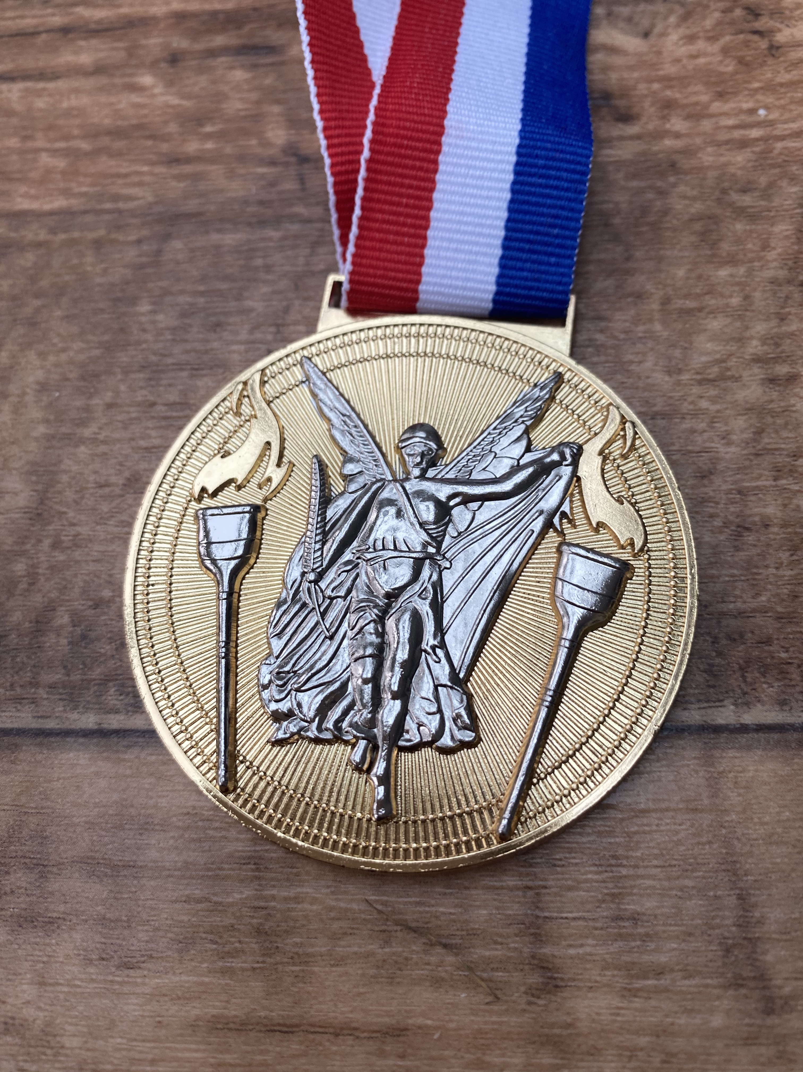
ROUTE DIRECTIONS!
Start at St Helens Church!
Left onto Buryfield Road
Right onto Warwick Road
Cross over safely to Grange Road on the left
Left at the roundabout onto St Bernards Road
Left onto Streetsbrook Road
Right onto Dorchester Road
Cross over safely and run through Tudor Grange car park , onto the park path, which you follow straight and pop out near the railway bridge opposite Monkspath Hall cark, head towards St Alphege Church!
Brace hard as you run UP Church Hill Road, which then turns into New Road
Run down in between the flats and past our sponsor Simon Burt the Estate Agents offices, into Malvern Park! Follow the park path down and turn left at the horse statue, then right down the skinny path and follow the path as if it were a lap of Parkrun!
Out of the park in the duck pond end car park and bear left, then cross over safely onto Marsh Lane, running past the wonderful Marie Curie Hospice on your right! BE CAREFUL some of this road has no path!
Cross over safely at the top and run down Hampton Lane, then turn right down Ravenshaw Lane (no path) and immediate left onto Berry Hall Lane (no path) which is half way *refreshment station*!
At the top, turn left on Henwood Lane (no path) and then right at the top back on Hampton Lane, running past The Boat pub, over the bridge and turning immediate left onto Bickenhill Lane!
This then bears left onto Catherine-de-Barnes Lane and you run all the way towards the airport, passing the Dogs Home and the curling ground, turning left at our volunteer marshal and following the path which leads you round and left along the top of the Coventry Road!
Turn left onto Old Damson Lane (no path) and then follow this up Damson Parkway with all the new JLR buildings either side of you!
At the roundabout, turn left staying on Damson Parkway, running up all the way to Yew Tree Lane where you turn right!
Yew Tree Lane turns into Cornyx Lane and you turn left up Hermitage Road!
At the top, cross safely over Lode Lane and down Seven Star Road, turning left at the bottom into St Helens and to the FINISH and the glory and goodie bag!
BLING!
Cross safely = there is a light
controlled crossing - please use! Where the route
dictates to cross any busy roads with no
pedestrian crossing
please be very careful
No path = please follow the Highway Code
and run safely so cars and other
road users can see you clearly and in
time to give you a wide berth
Spectators can park safely near/on the route
on a side road and cheer on!

